Slide 1
G
-
Employee Churn Analysis

Slide 2
Group Members
D1161 - Samet
D1366 - Necip
D1649 - Fatih
Group Mentor
Mary

Slide 3
Contents
01
Data Cleaning & EDA
02
Data Visualization
03
Model Building
04
Model Deployment

Slide 4

Tools
JUPYTER NOTEBOOK
STREAMLIT
PYTHON
API
Scrapy
Selenium

Slide 5
Employee Churn Analysis
Welcome to "Employee Churn Analysis Project". This is the second project of Capstone Project Series, which we will be able to build our own classification models for a variety of business settings.
Also we will learn what is Employee Churn?, How it is different from customer churn, Exploratory data analysis and visualization of employee churn dataset using matplotlib and seaborn, model building and evaluation using python scikit-learn package.
We will be able to implement classification techniques in Python. Using Scikit-Learn allowing we to successfully make predictions with the Random Forest, Gradient Descent Boosting , KNN algorithms.
At the end of the project, we will have the opportunity to deploy your model using Streamlit.

Slide 6
Employee Churn Analysis
General Information
In this project we have HR data of a company. A study is requested from we to predict which employee will churn by using this data.
The HR dataset has 14,999 samples. In the given dataset, we have two types of employee one who stayed and another who left the company.
We can describe 10 attributes in detail as:
satisfaction_level: It is employee satisfaction point, which ranges from 0-1.
last_evaluation: It is evaluated performance by the employer, which also ranges from 0-1.
number_projects: How many of projects assigned to an employee?
average_monthly_hours: How many hours in average an employee worked in a month?
time_spent_company: time_spent_company means employee experience. The number of years spent by an employee in the company.
work_accident: Whether an employee has had a work accident or not.
promotion_last_5years: Whether an employee has had a promotion in the last 5 years or not.
Departments: Employee's working department/division.
Salary: Salary level of the employee such as low, medium and high.
left: Whether the employee has left the company or not.

Slide 7
STEPS
Step 3
Step 5
Step 1
Model Building
Final Presentation
Data Cleaning & Exploratory Data Analysis
Step 2
Step 4
Data Visualization
Model Deployment

Slide 8
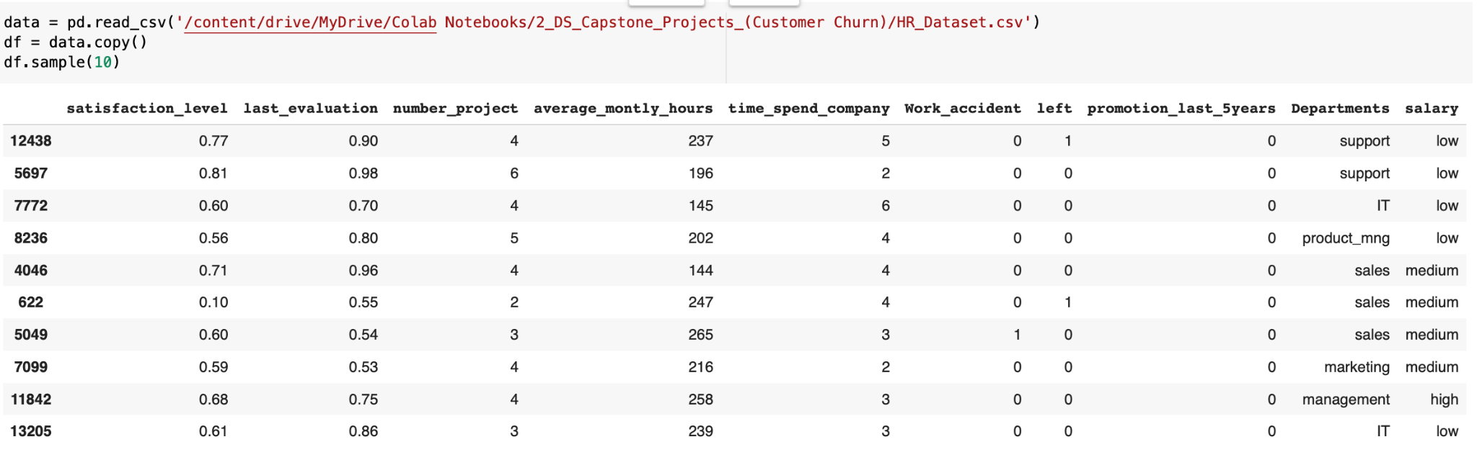
Quick Look at Our Dataset
STEP 1

Slide 9
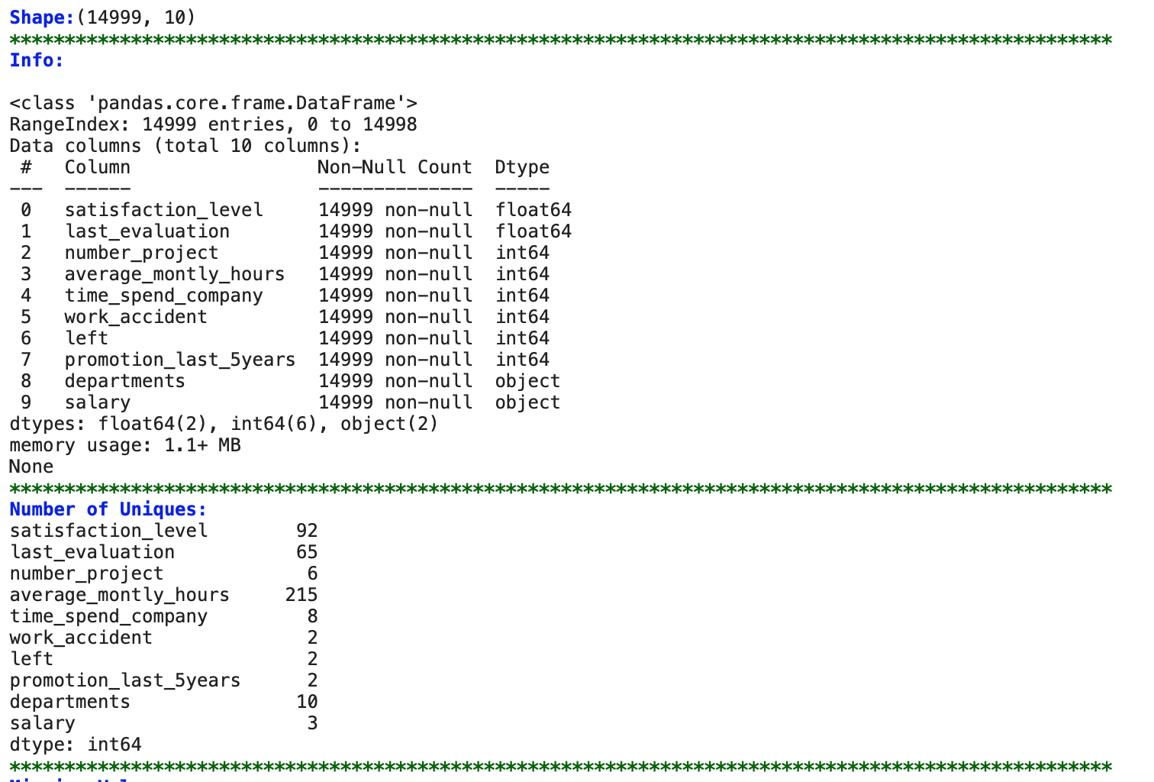
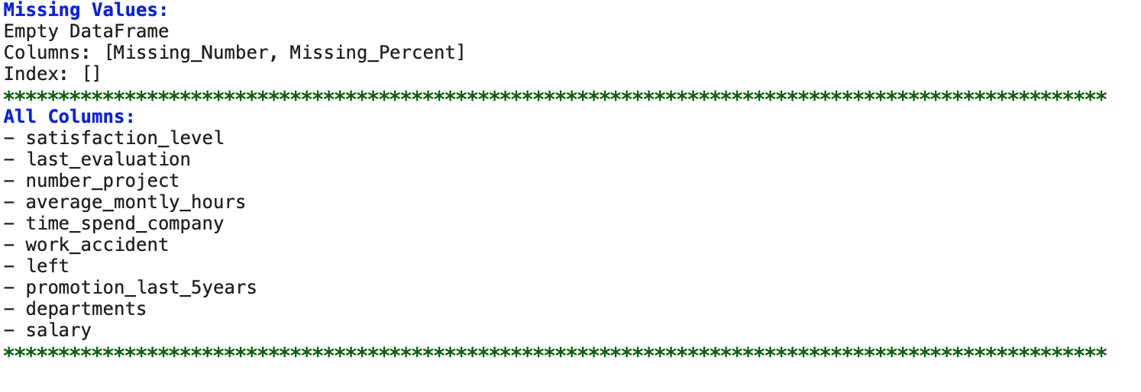
STEP 1

Slide 10
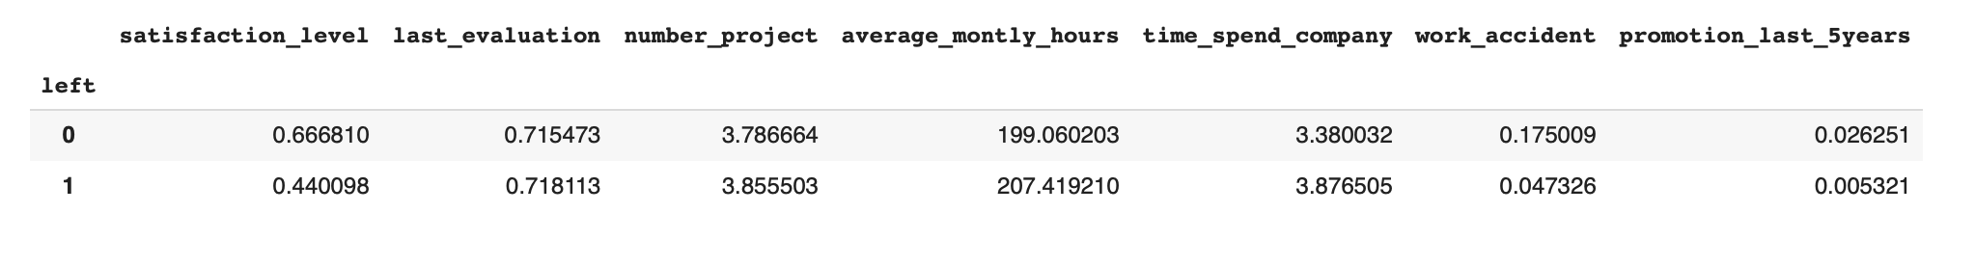
Comparing Left and Stay
STEP 1

Slide 11
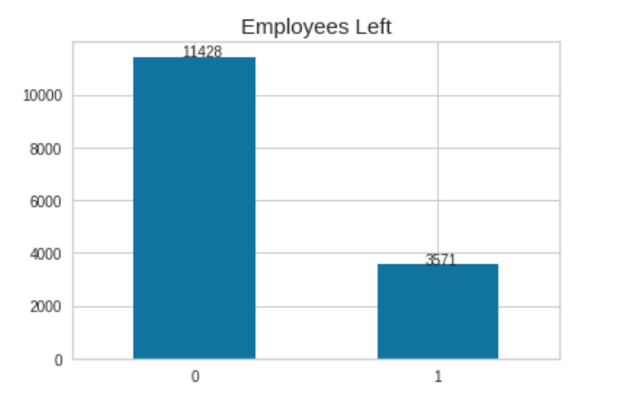
STEP 2
RECENCY

Slide 12
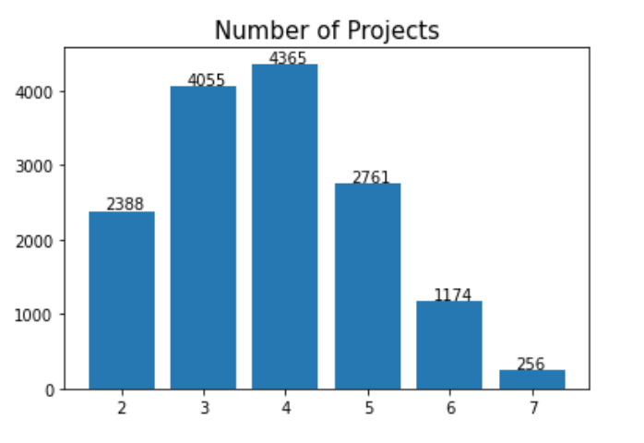
STEP 2
FREQUENCY

Slide 13
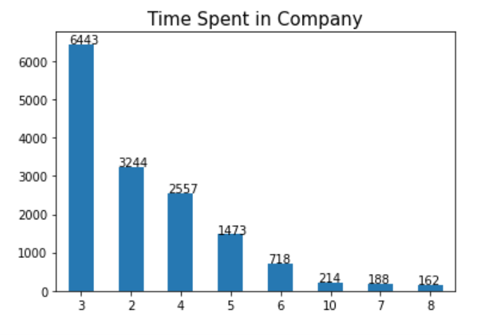
STEP 2

Slide 14
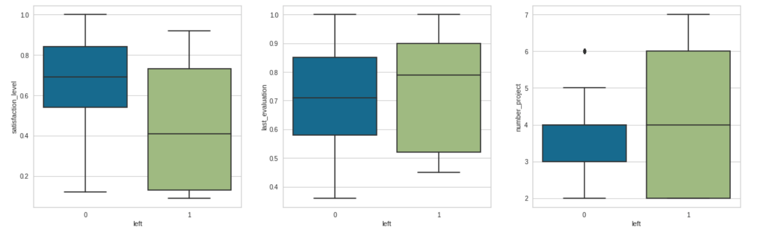
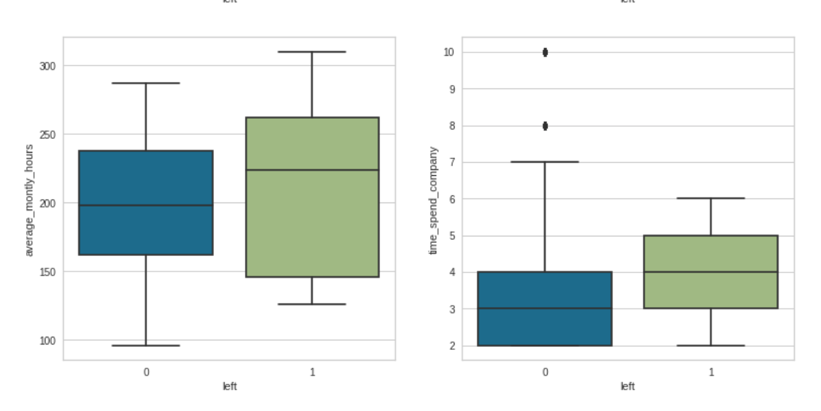
STEP 2

Slide 15
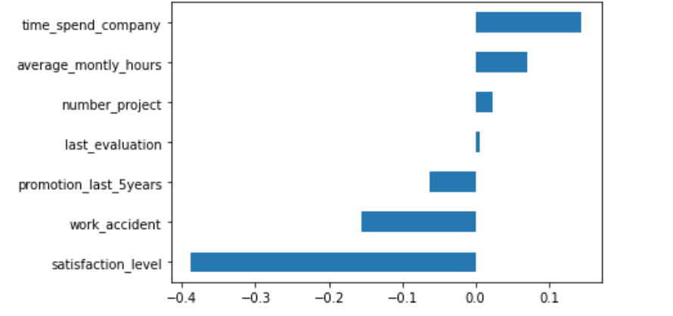
STEP 2
Correlation

Slide 16
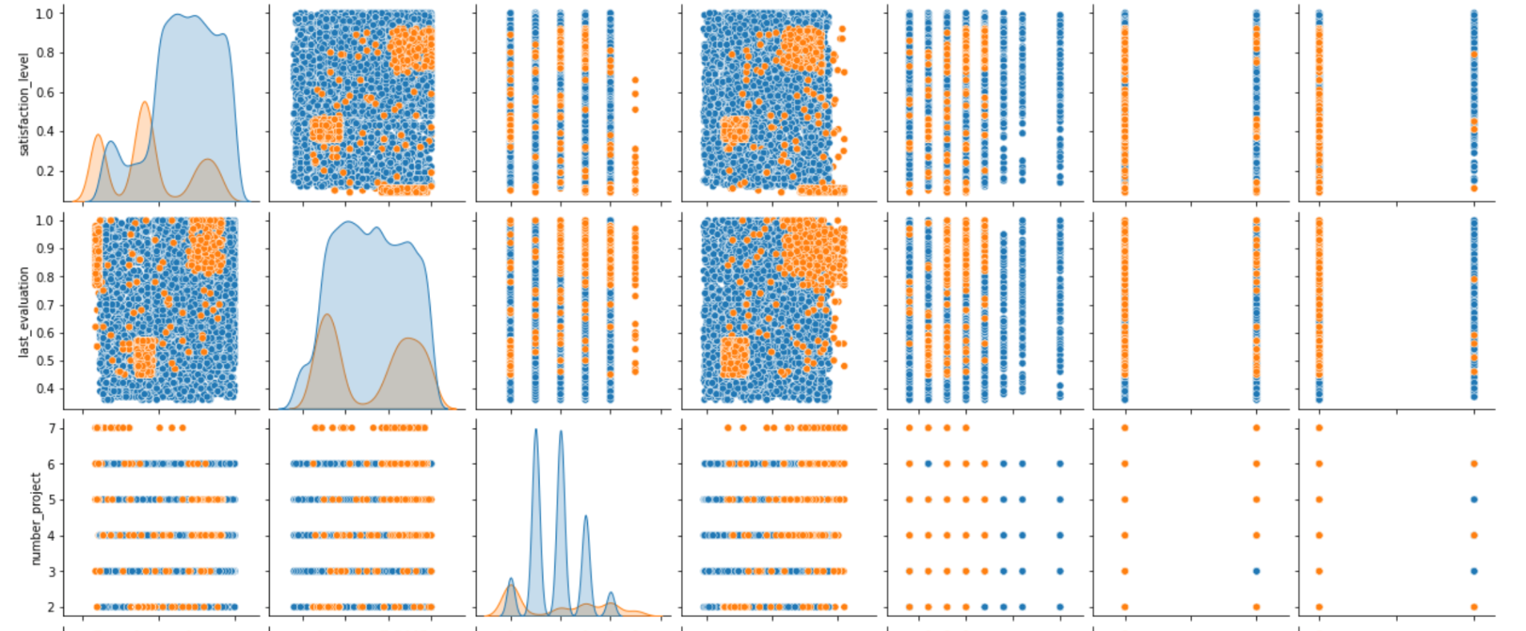
STEP 2
We checked their distribution
%34
%35
%31
47%
31%
22%

Slide 17
STEP 3
MODEL BUILDING

Slide 18
STEP 4
MODEL DEPLOYMENT

Slide 19
NOTEBOOK

Slide 20
FEEDBACKS

Slide 21
THANK YOU

